Slide 1


ENGR 1111 Intro to Engineering: Civil Engineering Fall 2022 Part 7: Environmental Engineering Calculations

Slide 2
Part 7: Environmental Engineering Calculations
Objectives
Units and Dimensions
Units of Concentration for Liquid and Gas Phases
Density
Concept of Flow Rate and Residence Time
Precision and Accuracy

Slide 3
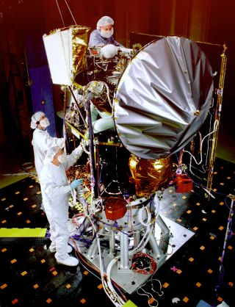

Part 7: Environmental Engineering Calculations
Why are units important?
A number without units has no meaning in engineering
A number with improper units has a misleading meaning
Example:
1999 Mars Climate Orbiter
Launched in December 1998, communication lost in September 1999
Measurement mismatch failure
NASA used metric while the manufacturer used US customary units

Slide 4
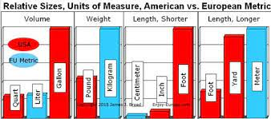
Part 7: Environmental Engineering Calculations
Dimensions – used to describe the measurable aspects of an object
Units – increments necessary to quantify dimensions
Common dimensions:
Length
Mass
Time
Temperature
Derived units:
Volume
Density
concentration

Slide 5
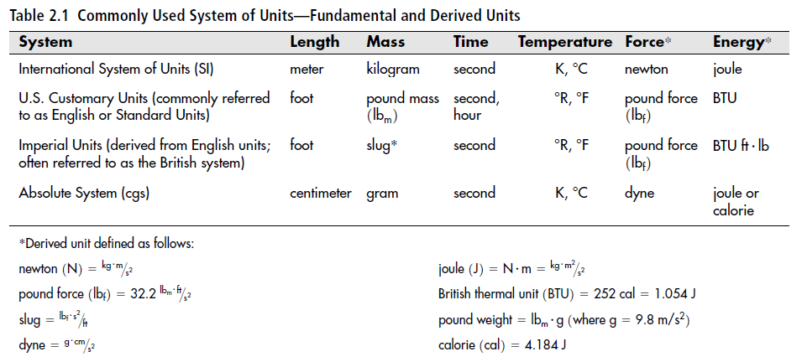
Part 7: Environmental Engineering Calculations

Slide 6
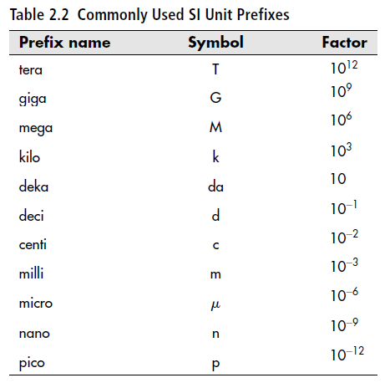
Part 7: Environmental Engineering Calculations

Slide 7
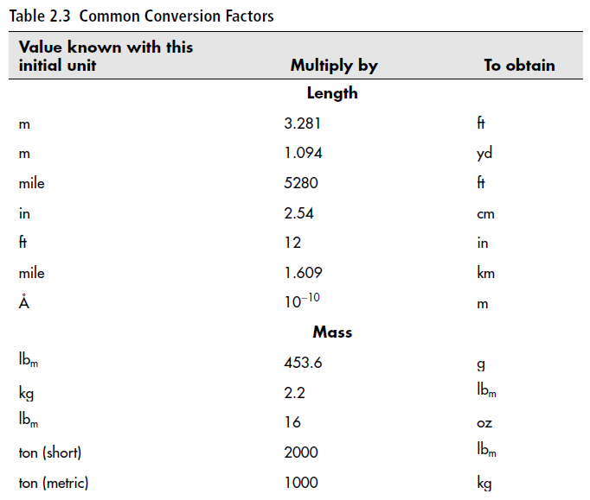
Part 7: Environmental Engineering Calculations

Slide 8
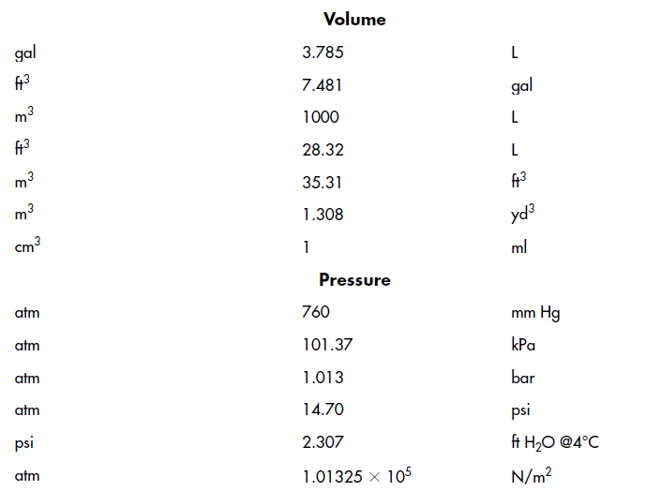
Part 7: Environmental Engineering Calculations

Slide 9
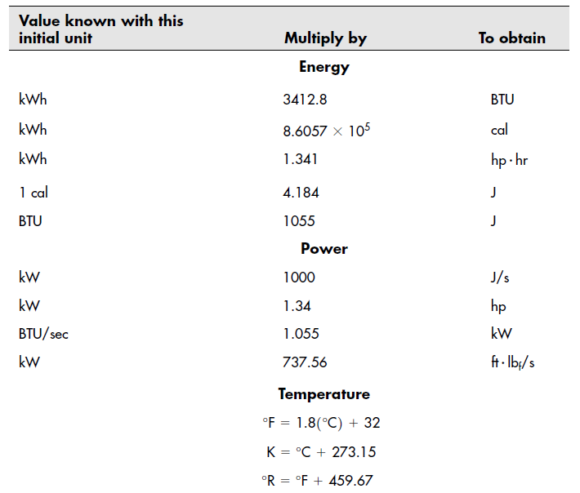
Part 7: Environmental Engineering Calculations

Slide 10
Part 7: Environmental Engineering Calculations
Significant Figures
Measurements are uncertain, therefore only meaningful numbers are used.
Three rules in determining significant figures:
Non-zero digits are always significant.
Any zeros between two significant digits are significant.
A final zero or trailing zeros in the decimal portion ONLY are significant.

Slide 11
Part 7: Environmental Engineering Calculations
Significant Figures
Non-zero digits are always significant.
How many significant figures are in the following?
25.74 – 4 sig figs
66.4 – 3 sig figs
7.3 – 2 sig figs
12.5 – 3 sig figs

Slide 12
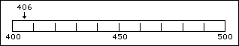
Part 7: Environmental Engineering Calculations
Significant Figures
Any zeros between two significant digits are significant.
Given the number 406, how many numbers are significant?
4 and 6 are significant by the first rule
To make a measurement decision on the 4 (in the hundred’s place) and the 6 (in the unit's place), a decision has to be made on the ten's place. The measurement scale for this number would have hundreds and tens marked with an estimation made in the unit's place.

Slide 13
Part 7: Environmental Engineering Calculations
Significant Figures
A final zero or trailing zeros in the decimal portion ONLY are significant.
How many significant figures are in the following?
0.00600 – 3 sig figs
0.03040 – 4 sig figs
2.50x10⁻⁵ – 3 sig figs
4.300x10¹⁴ – 4 sig figs

Slide 14
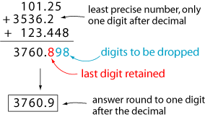
Part 7: Environmental Engineering Calculations
Significant Figures
Addition and Subtraction
Count the number of significant figures in the decimal portion of each number in the problem.
Add or subtract in the normal fashion.
Round the answer to the LEAST number of places in the decimal portion of any number in the problem.

Slide 15
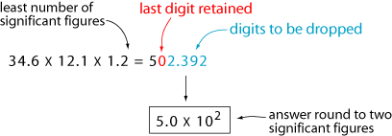
Part 7: Environmental Engineering Calculations
Significant Figures
Multiplication and Division
The LEAST number of significant figures in any number of the problem determines the number of significant figures in the answer.

Slide 16
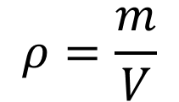
Part 7: Environmental Engineering Calculations
Density – the ratio of mass to a unit volume
Where,
ρ = density, kg/m³
m = mass, kg
V = volume, m³
$$ρ=\frac{m}{V}$$
Density is independent of sample size but varies with temperature or the concentration of impurities
Example: saltwater vs fresh water

Slide 17
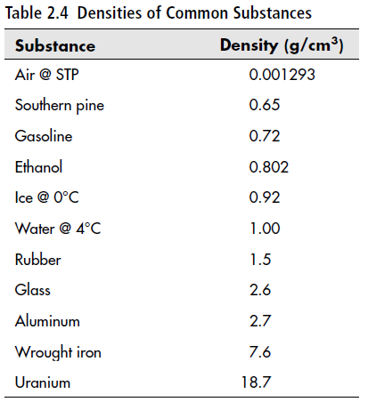
Part 7: Environmental Engineering Calculations

Slide 18
Part 7: Environmental Engineering Calculations
Example 1:
A 2 L graduated cylinder initially contains 500 ml of water. An irregularly shaped object having a mass of 105 g is submerged into the water. The final volume of the water in the cylinder is 1025 ml. Determine the density of the object.

Slide 19
Part 7: Environmental Engineering Calculations
Example 2:
During an environmental assessment of a natural wetland in the Everglades, it was determined that 1.5 cubic meters of the dry native soil had a mass of 420 kg. Determine the mass of a cubic foot of that same soil.

Slide 20
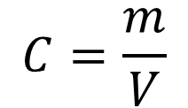
Part 7: Environmental Engineering Calculations
Concentrations – a concentration of a substance dissolved in a liquid are often described on a mass-per-unit-volume basis
Where,
C = concentration of dissolved substance, mg/L
m = mass of solute or dissolved substance, mg
V = total volume, L
$$C=\frac{m}{V}$$

Slide 21
Part 7: Environmental Engineering Calculations
Mass-per-unit-mass basis
The most common mass-based units are parts per million (ppm) and parts per billion (ppb).
For perspective, the maximum contaminant level goal (MCLG) of mercury in drinking water allowed by the Environmental Protection Agency (EPA) is 0.002 ppm. This means that there can be no more than 0.002 grams of mercury in every million grams of drinking water purified and distributed by your local municipality.
Assuming the density of water is 1.0 g/ml, this is equivalent to allowing only 2 grams of mercury in approximately 264,000 gallons of drinking water.

Slide 22
Part 7: Environmental Engineering Calculations
Example 3:
In many environmental aqueous systems, it is appropriate to make the simplifying assumption that 1 mg/L is equal to 1 ppm, provided that the fluid in question is primarily water, so that the density of the solution is essentially 1 g/ml. Show that 1 mg/L = 1 ppm.

Slide 23
Part 7: Environmental Engineering Calculations
Molarity (M = moles per liter) – one mole per unit volume of substance
Avogadro’s number defines a mole (mol)
6.02 x 10²³ molecules of any material per mole
The atomic mass of an element or substance is equal to the mass of one mole of that substance

Slide 24
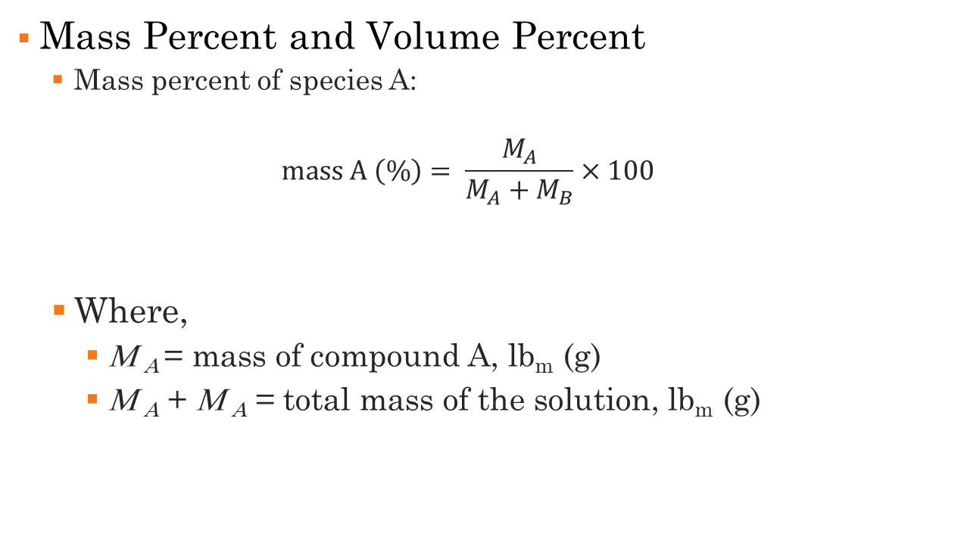
Part 7: Environmental Engineering Calculations
Mass Percent and Volume Percent
Mass percent of species A:
$$\text{mass} \text{A} \left(\text{\%}\right)= \frac{M_{A}}{M_{A}+M_{B}}×100$$
Where,
Μ _{Α} = mass of compound A, lb_{m} (g)
Μ _{Α} + Μ _{Α} = total mass of the solution, lb_{m} (g)

Slide 25
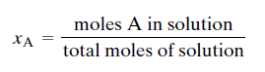
Part 7: Environmental Engineering Calculations
Mass Percent and Volume Percent
Volume percent of species A:

Slide 26
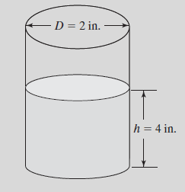
Part 7: Environmental Engineering Calculations
Example 4:
A researcher has added 2.06 g of the salt sodium nitrate to a cylinder containing water. The cylinder diameter is 2 inches and the depth of the water in the cylinder is 4 inches. Determine the concentration of salt in solution, showing your answer in the units specified.
Sodium Nitrate = 85 g/mole
Density of water = 1 g/ml
mg/L
mass %
molarity

Slide 27
ENGR 1111 Intro to Engineering: Civil Engineering Fall 2022 Part 7: Environmental Engineering Calculations

